Slide 1
Robust McNemar’s Test
Real Breast Cancer Dataset

Slide 2
Introduction
The dataset chosen for the McNemar’s Test if Real Breast Cancer dataset.
This dataset consists of a group of breast cancer patients, who had surgery to remove their tumour. The dataset consists of the following variables:
Age: age at diagnosis (Years)
Tumour_Stage: I, II, III
Histology: Infiltrating Ductal Carcinoma, Infiltrating Lobular Carcinoma, Mucinous Carcinoma
HER2 status: Positive/Negative
Surgery_type: Lumpectomy, Simple Mastectomy, Modified Radical Mastectomy, Other
Patient_Status: Alive/Dead [can be null, in case the patient didn’t visited again after the surgery and there is no information available whether the patient is alive or dead].

Slide 3
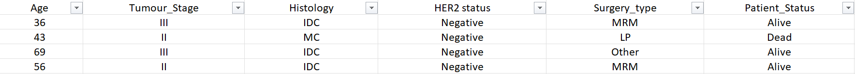

Slide 4
Hypothesis Testing I
HER2-positive breast cancer is a breast cancer that tests positive for a protein called human epidermal growth factor receptor 2 (HER2). This protein promotes the growth of cancer cells.
In about 1 of every 5 breast cancers, the cancer cells have extra copies of the gene that makes the HER2 protein. HER2-positive breast cancers tend to be more aggressive than other types of breast cancer.
H0: Breast cancer patients with a negative HER2 status tend to exhibit a higher survival.
H1: Breast cancer patients with a positive HER2 status do not exhibit higher survival. Treatment Group: Patients with HER2 Status negative. (29) Control Group: Patients with HER2 Status positive. (301)
Discordant pairs - 10

Slide 5
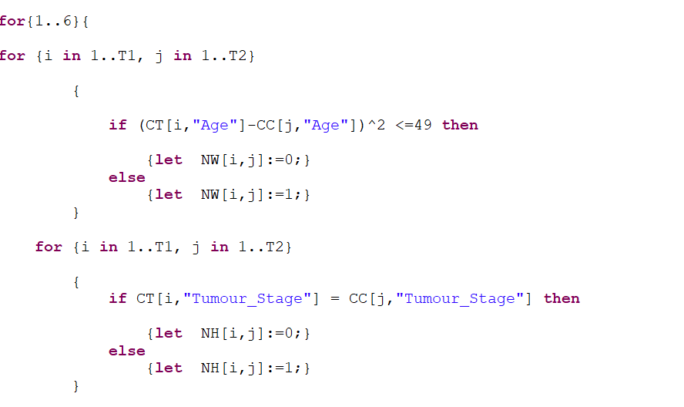
Run file snippet for Hypothesis I

Slide 6
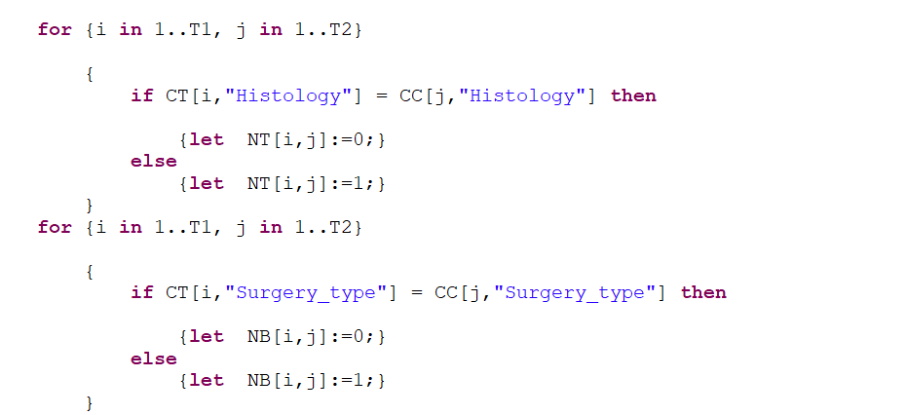

Slide 7
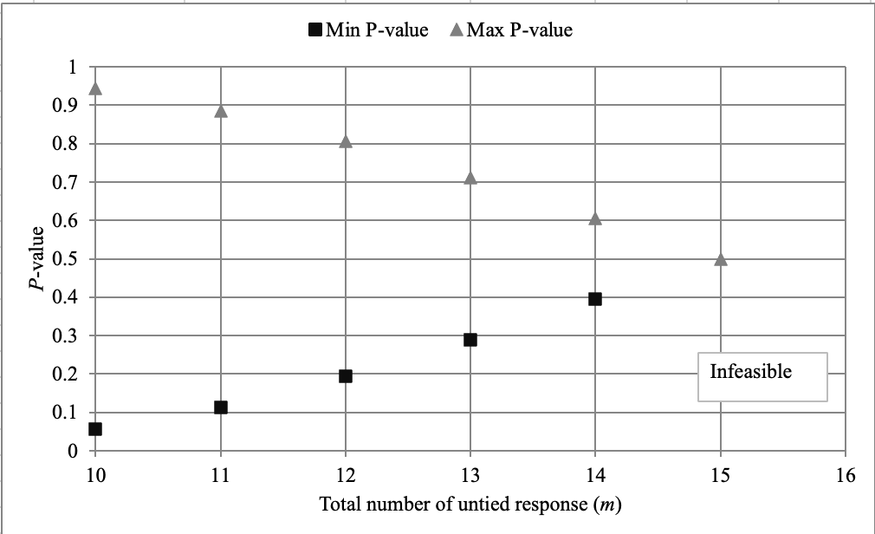
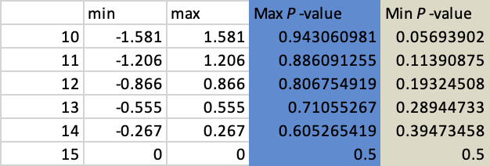
Results
Hypothesis 1: We accept the null hypothesis. Patients tested negative for HER2 status breast cancer have higher survival rate.

Slide 8
Hypothesis Testing II
Tumor Stage
H0: Breast cancer patients who are in Tumor stage 2 & 3 tend to exhibit a lower survival.
H1: Breast cancer patients who are in Tumor Stage 2 & 3 do not tend to exhibit a lower survival.
Treatment Group: Individuals who are in Tumor stages 2 and 3. (266) Control Group: Individuals who are in Tumor stage 1. (64)

Slide 9
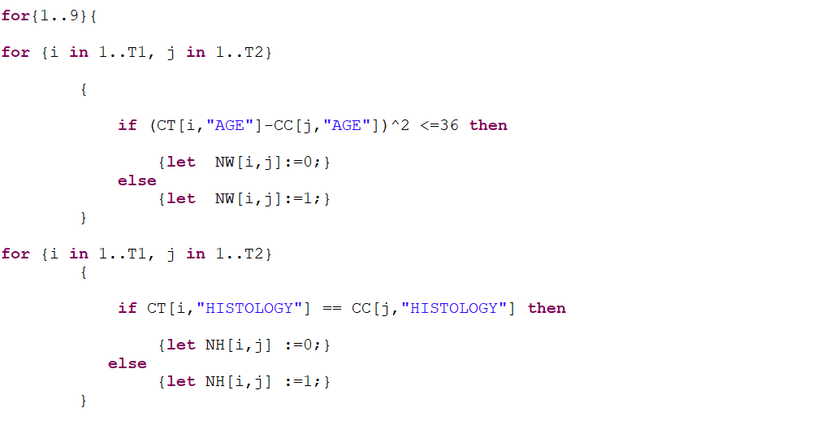
Run file snippet for Hypothesis II

Slide 10
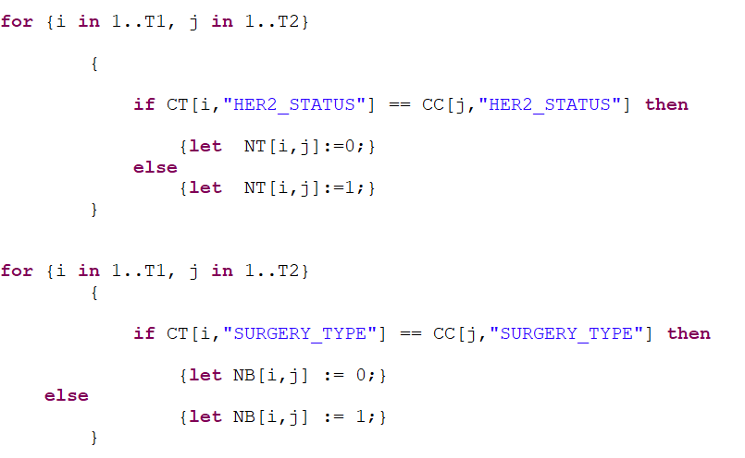

Slide 11
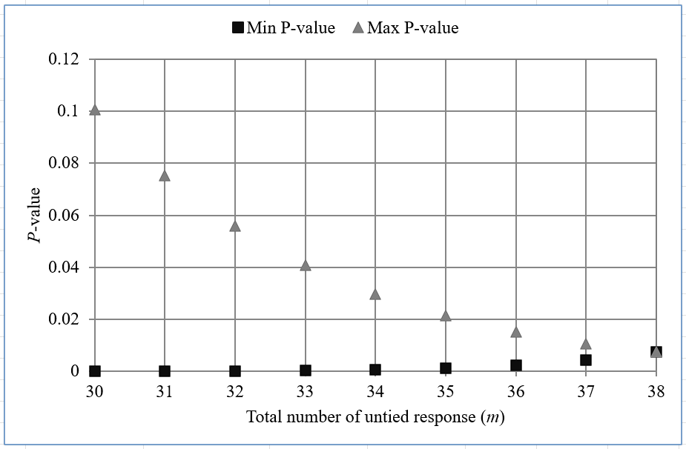
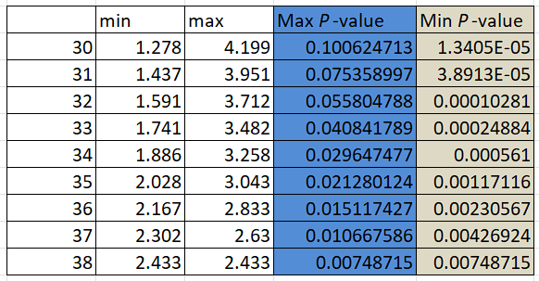
Results
Hypothesis 2: We reject the null hypothesis. Breast cancer patients with Tumor Stage 2 & 3 do not tend to exhibit a lower survival.

Slide 12
Thank you

